Slide 1
Functions
https://towardsdatascience.com/course-1-algorithmic-toolbox-part-3-divide-and-conquer-dd9022bfa2c0

Slide 2
Don’t Eat one big piece: Nibbling is good
Divide and conquer
Construct a program from smaller pieces or components (modules)
Each piece more manageable than the original program
Makes other functions smaller
Pieces can be independently implemented and tested
https://www.khanacademy.org/computing/computer-science/algorithms/merge-sort/a/divide-and-conquer-algorithms

Slide 3

Programmer-Defined Functions
Readability
Function name should indicate operations performed
Reuse
Functions may be used multiple times in the same program.
Functions may be used in the other programs
Use existing functions as building blocks for new programs
Avoid code repetition
Abstraction - hide internal details (library functions)

Slide 4

Program Modules
Functions
named series of statements.
Programs combine user-defined functions with library functions
Function calls
Invoking functions
Provide function name and arguments (data)
Function performs operations or manipulations
Function returns results

Slide 5

Program Modules
Function call analogy:
Boss asks worker to complete task
Worker gets information, does task, returns result
Information hiding: boss does not know details

Slide 6
User-Defined Functions
Can create your own functions, similar to print() or input()
Implements the subroutine/ procedure/ module/ function definitions of an algorithm.

Slide 7
Components of Function Use
Steps for implementing functions
Function definition
Function call
def cube(x):
return x*x*x
cube(2)
8

Slide 8
Writing User-defined Functions
Components:
the name of the function
its parameters
what it returns
block of statements to be carried out when the function is called
The block of statements is called the “function body”

Slide 9
Function Definitions
Syntax:
def function-name( parameter-list ):
Example:
def grade(score):
A parameter is a function input specified in a function definition like score
An argument is a value provided to a function's parameter during a function call like grade(56)

Slide 10
Function Definitions
Returning control
If nothing returned
until reaches the end
If something returned
return expression

Slide 11
Function Call
Using function name transfers control to function
Values are passed through parameters
Statements within function are executed
Control continues after the call
For value-returning functions, either
Store the value for later use
nf=fact(n)
Use the value returned without storing
print( "%d" %fact(n))
Throw away return value
fact(n)

Slide 12
Functions Calling Functions
Common for functions to call many other functions
Function can call itself➔Recursion

Slide 13

Function documentation
Used to aid in program maintenance
Comments at non-main definition header
Purpose of function
Parameters
Return
Use ''' Triple quotes '''

Slide 14
Return Values
Values are returned by copying a value specified after the return keyword.

Slide 15
Function examples
A function with no return/no parameter
Declaration:
def sayHello():
print(“Hello World!\n”)
Function call:
sayHello()

Slide 16
Function examples (cont.)
A function with no return but a parameter
Declaration:
def sayHello(name):
print(“Hello”, name)
Function call:
sayHello(‘Zeynep’)

Slide 17
Function examples (cont.)
A function with no return but two parameter
Declaration:
def sayHello(name,time):
print(“Good”, time)
print(“Hello”, name)
Function call:
sayHello(‘Zeynep’,’morning’)

Slide 18
Function examples (cont.)
A function with return a value and a has a parameter
Declaration:
def sayHello(name):
return “Hello ” + name
Function call:
greeting=sayHello(‘Zeynep’)

Slide 19
Example: Add two numbers and return the result

Slide 20
Examples
Write a function to print all numbers from 0 to x
Write a function to print all numbers from x to 0
Write a function to print all even numbers from 0 to x
Write a function to print all odd numbers from x to 0
Write a function to print x number of stars on a line
Write a function to print x number of stars one on each line
Write a function to print digits of x one on each line
Write a function to print digits of x in reverse order one on each line

Slide 21
Examples
Write a function to calculate a^{b} (a to the power b i.e. multiply a by itself b times)
Write a function that reverses an integer number. It does this by using the modulus % operator and result will be in a list.
Get a number from the user and print “Even” if it is an even number ”Odd” otherwise. Define a function to test a given number for being even or odd.
Get two numbers from the user and write a function that checks if the first one is divisible by the second one
Example Run:
Enter number 1: 24
Enter number 2: 4
24 is divisible by 4

Slide 22
Examples
Write functions for converting temperature values from Fahrenheit to Celsius and Celsius to Fahrenheit.
Show a menu and get selection of the user by functions.
Then calculate the corresponding value by calling functions that you defined depending on the user selection.
F = (9/5)*C+32 C = (F-32)*(5/9)

Slide 23
Examples
Example Run:
1. F to C
2. C to F
Your Selection: 1
Temperature: 59
59 F = 15 C
Example Run:
1. F to C
2. C to F
Your Selection: 2
Temperature: 15
15 C = 59 F

Slide 24
Dynamic typing
Can use any type
Result determined during runtime
def fun(a,b):
return a+b
fun(2,4)
6
fun(‘2’,’4’)
24

Slide 25
Scope
Variables declared in a function body (including formal parameters) are only accessible whilst the function is executing.
These are called local variables
In fact, this is true of any block in a program.
A variable defined outside of a function is global
A global variable's scope extends from assignment to the end of the file and can be accessed inside of functions
A global statement must be used to change the value of a global variable inside of a function.

Slide 26
Local vs global
year=2020
def change_local(y):
year=y
def change_global(y):
global year
year=y
>>> change_local(2021)
>>> year
2020
>>> change_global(2021)
>>> year
2021

Slide 27
Function scope
A function also has scope, which extends from the function's definition to the end of the file.
To be able to call a function, the interpreter must have already evaluated the function definition (thus binding the function name to a function object).
An attempt to call a function before a function has been defined results in an error.

Slide 28
Error: Function called before defining
change_local(2020) #error
def change_local(y):
year=y

Slide 29
Namespaces and scope resolution
A namespace maps names to objects like a table and Python keeps them
locals() and globals() show them
Scope is the area of code where a name is visible. How to?
Built-in scope – Contains all built-in names of Python, such as int(), str(), list(), range(), etc.
Global scope – Contains all globally defined names outside of any functions.
Local scope – Usually refers to scope within the currently executing function but is the same as global scope if no function is executing.
NameError if none of them have it

Slide 30
Arguments
pass-by-assignment use copies
Modifications inside functions:
If the object is immutable, such as a string or integer, then the modification is limited to inside the function. The original argument object unchanged.
If the object is mutable, then in-place modification of the object can be seen outside the scope of the function.

Slide 31

Mutable vs immutable arguments
nums=[1,2,3]
def change_immutable(y):
y=0
def change_mutable(y):
y[0]=0
>>> change_immutable(nums[0])
>>> nums
[1, 2, 3]
>>> change_mutable(nums)
>>> nums
[0, 2, 3]

Slide 32
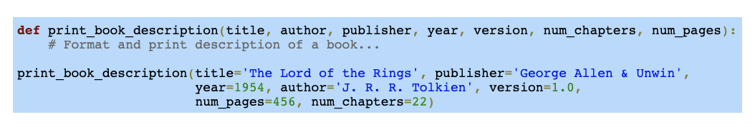
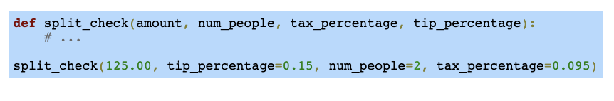
Keyword arguments and default parameter values
Hard to remember arguments and their order
Use keywords
Keywords can come after positional arguments

Slide 33
Default parameter values
Optional parameters
Use default values
If parameter is given use that one otherwise use default value
Come after positional

Slide 34
Default parameter values
def text(txt,bold=0,italic=0):
if bold==1:
print('Bold')
if italic==1:
print('italic')
print(txt)
>>> text('Zeynep')
Zeynep
>>> text('zeynep',1)
Bold
zeynep
>>> text('Zeynep',1,1)
Bold
italic
Zeynep

Slide 35
Arbitrary arguments
Sometimes a programmer doesn't know how many arguments a function requires.
A function definition can include a *args parameter that collects optional positional parameters into an arbitrary argument list tuple.

Slide 36
Arbitrary arguments
def course(c1,*args):
print(c1)
if len(args) > 0:
for c in args:
print(c)
>>> course('Python','Java')
Python
Java
>>> course('Python')
Python

Slide 37
Keyword arguments as dict
Adding a final function parameter of **kwargs creates a dictionary containing "extra" arguments not defined in the function definition;
kwargs is short for keyword arguments. The keys of the dictionary are the parameter names specified in the function call.

Slide 38
**kwargs
def course_cat(c1,**kwargs):
print(c1)
for c,ct in kwargs.items():
print(c,':',ct)
course_cat('C',Java='prog',Discrete='math')
C
Java : prog
Discrete : math

Slide 39
Multiple function outputs
Use a tuple to return more than one value
If fun multiple has a return x,y,z then
a,b,c=multiple()

Slide 40
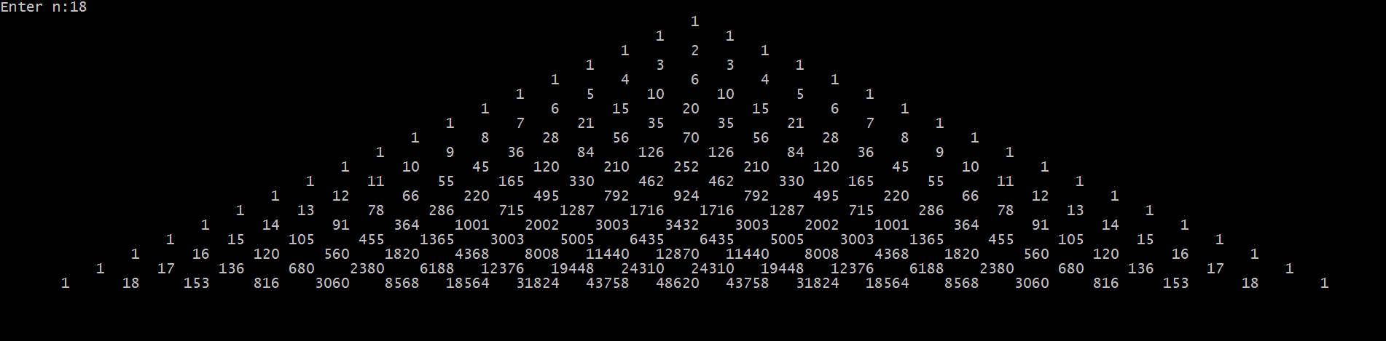
Challenge: Draw Pascal triangle

